Slide 1

Foundations of Entrepreneurship
Design, Innovation & Product Development
Lecture Note # 25
© Manoj K Mondal, RMSoEE
Image by Joshua Sortino: https://unsplash.com

Slide 2

Creativity
Mechanism of innovation
TRIZ
Design thinking
Design-Driven Innovation
Open innovation
Introduction to IPR

Slide 3
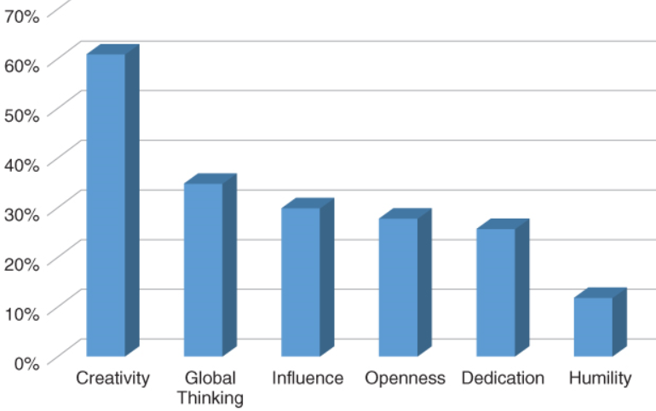
In 2010 IBM conducted study on 1541 Global CEOs on Leadership Quality
Percentage of executives listing the attributes as 1 of top 3 leadership qualities

Slide 4
Design and Designers’ Sensibilities
Design is an art of creating beautiful, elegant, and innovative solutions those meet (or exceed) customers’ aspirations.
Sensibility refers to complex feelings such as amenity, pleasantness, comfort, pleasure, and so forth, which are often experienced in the use of objects.
The senses of vision, hearing, smell, touch, and taste.
Sensation and perception that generate the capacity of emotional, rational, ethical, artistic, literal, social, and cultural understanding, called ‘sensibility.’

Slide 5
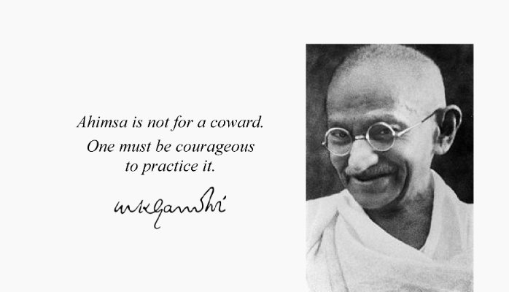
Gandhi: one of the few creative geniuses to walk the earth

Slide 6
Linear Thinking
Research
Analyze
Plan
Budget
Execute
validate
Build
Launch
Evaluate
Adopt
Iterative Problem Solving Process:
Learning by doing
Notes:
However, novel situations and problems require us to act more like curious children than analytical MBA graduates. We certainly must do our homework, collect data, and formulate a strategy. Before too long, though, we must take actions, reflect, and learn, and then adapt accordingly. We cannot expect to develop the perfect plan while sitting in our office amidst a pile of research reports. Instead, the creative problem-solving process involves going out into the world and engaging in a healthy dose of trial and error. We must learn by doing.

Slide 7
Design Process
Identify pain
Define the problem
Ideate possible solution
Prototype selected idea
Evaluate prototype
Redesign based on feedback from users
The systems development life cycle, also referred to as the application development life-cycle

Slide 8
Innovation is difficult to plan, if at all possible.
You really do not plan like you plan a straightforward production process or execution plan.
It is more like a meandering river leading you through unknown territory, and that should be OK.

Slide 9
Some of the Constructs or Tools in Design and Innovation are
Design Thinking
Design-Driven Innovation
TRIZ – Theory of Inventive Problem Solving
Open Innovation
Lean Product Development
Agile Process
Frugal Innovation
Biomimetic

Slide 10
Design Thinking
EMPATHY
Observe and interview users in their natural environment, know their pain by suffering it
Generate insights and define the problem(s) to be solved
IDEATE
Brainstorm a diverse array of possible solutions
Garner positive and negative feedback from users
PROTOTYPE
Create a visual representation of several promising concepts
TEST
DEFINE

Slide 11
Many notice Design Thinkers among great creators
Notes:
leonardo

Slide 12
How Innovation Usually Happen?
Keep an open eye and demand better product or service.
Ask yourselves: Can I come up with something better?
Phanindra Sama faced a problem. He realized that others also would face the same problem. He asked himself: can I come up with a solution?
The results was redBus. The ibibo group took over redBus for $138 million.
Be active, go to places, look around, be mindful.

Slide 13
Develop Deep Empathy for Customers
Empathy makes you a better innovator – Satya Nadella, CEO, Microsoft
The greatest trait differentiating human beings from other creature is empathy.
Empathy is a combination of three things – seeing with the eyes of another, listening with the ears of another and feeling with the heart of another. By empathizing, one can define a problem well, conceive a creative solution resulting in breakthrough innovation.

Slide 14
Question the Status Quo: Be a Contrarian
Most of us compromise and manage or complain.
A contrarian questions the status quo and takes up a contrary view.
Starts building and testing hypothesis. They discover blue ocean markets.
Phanindra Sama, Dhirubhai Ambani, Dr Venkatswamy of ‘Arvind Netralaya’, Steve Jobs, Elon Musk, Jeff Bezos, Jack Ma created success stories by questioning the status quo

Slide 15
Invention and Innovation
Invention is creation of something new and meaningful.
Innovation is creation of something new that is meaningful and putting the required infrastructure and create value for the society.
The filament used in light bulb was invented by several researchers, but their inventions were not useful as a product.
Thomas Alva Edison invented material and the concept of the vacuum glass container to make it a useful product that lightened the society.
It created new industries and changed lives.

Slide 16
Idea to Invention to Innovation is the Process of Building Entrepreneurship
Invention
The creation of something new
Results in new knowledge
Drucker has stated that “…Innovation … is the means by which the entrepreneur either creates new wealth-producing resources or endows existing resources with enhanced potential for creating wealth.”
Innovation
Transformation of an idea into useful application
Results in new product / service/ process

Slide 17
Steps in Invention
Problem
Define
Question
Leap of faith
Hypothesis
Explore
Look around
Research

Slide 18
Leap of Faith
One must believe that it is possible to find a better solution than what exists to date.
That it is possible to come up with new ideas that can potentially serve to alleviate a pain or serve unmet needs.
Some call it confidence.
But a solution will always elude us as long as we think “never heard of anything better” or “this is the best possible solution” or “have to somehow manage” and brand some as ‘crazy’ if one thinks differently.

Slide 19
Being mindful of the travails you are going through, I am trying to arrange talks by experts instead of delivering lectures by myself. Schedule for the next part of the semester
25.03.2021 | Preetam Prashun | Entrepreneur, presently stationed in Vienna, Austria
26.03.2021 | Class test - 3
31.03.2021 | Dr. Ajai Chowdhry | Co-founder of HCL, Padma Bhushan, nothing short of a Bharat Ratna
01.04.2021 | Class test - 4
02.04.2021 | Capital budgeting
07.04.2021 | Talk by Aneesh Reddy of Capillary Tech | 2005 graduate and the Co-founder of Capillary Tech
8.04.2021 | Sourav: Product development | Intel
09.04.2021 | Final examination
14.04.2021 | Assignment to be submitted by 14.04.2021

Slide 20
For persistently Following and Succeeding in Creative Pursuit
Get rid of the tunnel vision, which is a great obstacle against thinking out of the box. Examples
Lateral thinking - Lateral thinking is a manner of solving problems using an indirect and creative approach via reasoning that is not immediately obvious. It involves ideas that may not be obtainable using only traditional step-by-step logic.
Leap of faith
Divergent thinking – use Sinectics
Step 1 Name your problem , Step 2 Brainstorm analogies to your problem, Step 3 Let the team(s) pick up the analogy they like the most, Step 4: Brainstorm ideas how to solve the analogy problem, Step 5: Translate the brainstormed solutions back to the context of the original problem
The same process can be simulated in your brain, most of the times without any chronology.

Slide 21
How to Identify Problem and How to Find Solutions?
Need to engage to identify a problem.
Rather than compromising on difficulties, we need to question how the difficulty can be overcome. Question the status quo.
Every problem has solutions. But solution starts with questioning.
James Dyson noticed that a traditional vacuum cleaner loses suction as the bag fills up.
His leap of faith was that a solution is definitely possible.
He chanced upon how sawdust was removed from the air by large industrial cyclones and comprehended to replicate it in domestic vacuum cleaner.

Slide 22

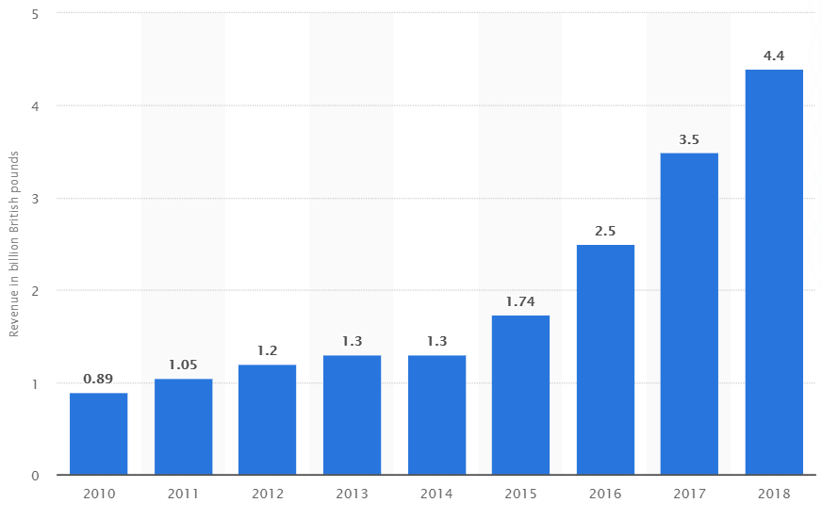
Dyson Vacuum Cleaner
It took him years to develop a product and get it market validated. Built 5127 prototypes.
But when launched, Dyson’s machine became the biggest selling vacuum cleaner in the UK in just 18 months.
This also evidences that applying a little creative thinking, a mass-used consumer product can be innovated.
The company generated revenue of $7.3 billion in 2019 and $ 1.5 billion profit. 13,000 employees

Slide 23
How the Invention Process Works in our brain?

Slide 24
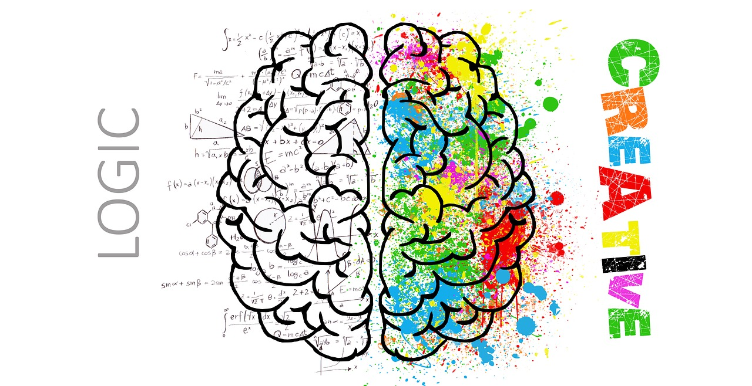

Two Compartments of the Brain
Conscious and subconscious

Slide 25
The Creative Process
Researches have shown that the creative process can be perceived to be a five step process. The process starts from problem identification and definition:
Idea germination – the seeding stage of a new idea: Recognition
Preparation – conscious search for knowledge: Rationalization
Incubation – subconscious assimilation of information: Fantasizing
Illumination – recognition of idea of being feasible: Realization
Verification – test to prove idea has value: Validation
The speed varies based on context and urgency.

Slide 26

1. Idea Germination
Exact mechanism is yet to be known.
Experts believe that once a problem is identified, our brain starts exploring solutions from its own reservoir of information, starts making permutation and combination of the diverse pieces of information.
It appears as if suddenly some combination emerges in the brain as a plausible solution.
Gradually, pieces start falling into place.

Slide 27
2. Preparation: Rationalization
Once an idea is seeded, the brain embarks on conscious search for increasingly better fit of the solution to the problem.
A continuous back & forth, between conscious and subconscious, information transfer on new solution vis-à-vis validations happen.

Slide 28

3. Incubation: Fantasizing
Our subconscious takes charge as if we tell our subconscious to churn the idea and find a solution.
The subconscious assumes control of the creative process, tirelessly works to find a solution without our conscious knowledge. This art of joining different pieces of information to create new knowledge by subconscious is known as ‘synectics’.
Immediately on finding a solution, the subconscious relays the information to the conscious and we have the ‘eureka’ moment as if it came from nowhere, so all of a sudden.

Slide 29
It is not all so sudden though it appears so.
We tend to think the idea appeared suddenly in a flash.
The fact is that the subconscious did a lot of research to come to this stage.
Some external stimuli may have aided the subconscious. Newton who have researched for decades to discover the gravity or Archimedes to discover buoyancy or Graham Bell the telephone.
It is believed that we use the left-brain skills to harvest the right-brain ideas, as if the right brain is the wood and the left brain is the tool to do the curving.

Slide 30


Our Subconscious is Much More Powerful than the Conscious Brain. The moot question is can we exploit it more than we usually tend to do.
Though there are not many empirical evidences, you may perhaps tell your subconscious to perform tasks.

Slide 31

4. Illumination: Realization
The conscious brain starts adding value to the idea from its cognitive reserve of knowledge.
Iterates and validates repeatedly.
A moment comes when it appears that the perfect solution has been received. You say ‘Aha, I see’.
Illumination may trigger by an external event. Like Alexander Graham Bell and Marie Curie.
Notes:
Marie Sklodowska Curie

Slide 32
5. Verification: Validation
At this stage the cognitive brain takes over, helps to make prototypes, and helps to validate.
Eventually, the idea is converted into a commercially relevant technology.

Slide 33
Innovation and Entrepreneurship
Entrepreneurial effort is essential to translate an illuminated idea into a validated, realistic, meaningful, and useful technology/product/ process/service.
This process is often tedious and requires perseverance and commitment.
Many ideas fall by the wayside.
Very often aspiring entrepreneurs come to realize that someone somewhere has already filed a patent on the technology that has been assiduously developed with much of efforts, time, and resources.

Slide 34
The right brain skills are crucial for creative vision.
But innovation does not occur until left-brain rationalization takes place.

Slide 35
Design-Driven Innovation
Design-driven innovation aims to produce products that are useful and meaningful to customers.
It is about introducing new meaning in a product or service that gives customers unique experience and unique sense of wellbeing

Slide 36
Meaning (Experience) in a Product
The meanings that a product or service might have for its users include the memories it invokes, the extent and quality of interaction and enjoyment.

Slide 37
Add Meaning to Product through Design Gain sustainable competitive advantage by giving customers unique experience
Technological innovations are important for business success. But capability to innovate meaning can add unique value that is difficult to emulate.
Recent evidence is testimony that companies who are successful in packaging meaning in their offerings could create and maintain competitive advantage and brand value over a long period of time.

Slide 38
Meaning in a product or service
The alternate path to innovation (alternative to the linear path) aims to discover not how things work, but why we need things. It gives customers something more meaningful—something they can love.
Roberto Verganti describes the work of companies, including Nest Labs, Apple, Yankee Candle, and Philips Healthcare, that have created successful businesses by doing just this.
Radically innovate the meaning of products and propose new reasons to buy them so that customers buy them repeatedly.
Reference: Design-driven Innovation: Changing the Rules of Competition by Radically Innovating what Things Mean
Book by Roberto Verganti

Slide 39
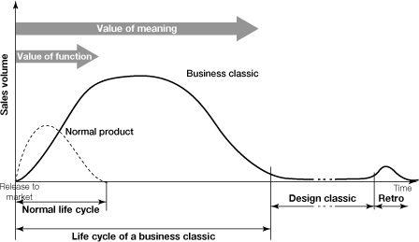
Radical innovation of meanings and the creation of business classics
Value of meaning
The image demonstrate how incorporation of meaning (shown as Business classic) leads to enormous rise in sales volume and life of the product over a long period of time.
Value of Function
Source: Design-Driven Innovation - by Roberto Verganti

Slide 40

Yankee Candle
Price: ₹20,006.00
Notes:
smell, odour, fragrance, scent, perfume,

Slide 41
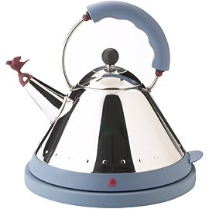
The Alessi Bird Kettle
Featuring the bird that sings when the water is boiling.
It has transformed the breakfast experience in many households by infusing an aura of originality, uniqueness and prestige.
Having sold millions of units, the Alessi 9093 kettle remains one of the Milan-based company’s most successful products to date. New meaning giving new experience.

Slide 42
Example: Nintendo introduced the Wii in 2006.
The gaming industry’s convention was that success of new consoles depended on more “power.”
Nintendo, instead of following this model to compete with Sony and Microsoft, focused their intent on how many more people they can get to play games.
Nintendo innovators developed the wireless Wii remote that anyone could use with gestures and spatial movement.
Games were converted from being sedentary to being ultra-active.
Urban condo-dwellers, country ranchers, parents with children, and even grandparents started enjoying the Wii.

Slide 43

Nintendo Wii
Game console makers strive to add more power.
Nintendo changed the game not by boosting power, but by introducing new meaning.
Game is no longer a sedentary and inactive process, but a community based work-out with all the entertainment elements.
Picture courtesy: http://www.dashhacks.com/wii-u/wii-u-news/

Slide 44
Design-Driven Innovation
Design & Meaning – Innovating meaning that makes sense of things
Design-Driven Innovation creates unique values - Brand equity, competitive position, and customer loyalty.
Radical Push (radical innovation of meaning) – Rarely pulled by users but is proposed by firms.
Technological innovation and innovation of meaning – Simultaneously excelling in both is the key.

Slide 45
DDI: Radical innovation of meaning giving customers new experience Two important features of a product: 1. latest technology (efficacy), 2. exciting experience (meaning)
Radical change
Domain of sustainable Competitive Advantage
Technology push
Technology
Design-Driven
Market pull
(User-centered)
Incremental change
Incremental change
Meaning
Radical change

Slide 46
Process of Design-Driven Innovation (DDI)
Listening – gaining access to new knowledge
Interpreting (The interpreter) - combining the gathered knowledge with your own insights into a unique proposal
Addressing - addressing the proposal via the interpreters, who prepare the people and context.

Slide 47
Design-Driven Innovation
Design-Driven Innovation is the strategy about the R&D process for innovating products or services that have new meanings that customers do not expect but they eventually love: those that convey new reason for customers to buy them.
Products and services resulting out of design-driven innovation process provide unique sustainable competitive advantages.

Slide 48
TRIZ
Theory of Inventive Problem Solving

Slide 49
TRIZ – “theory of inventive problem solving” invented by the Russian engineer Genrich Altshuller
Altshuller noticed patterns in invention disclosures.
Altshuller discovered that 98% of patented innovations originated from an already known principle.
He found hat only 2% of all patents were based on ground breaking principles.

Slide 50
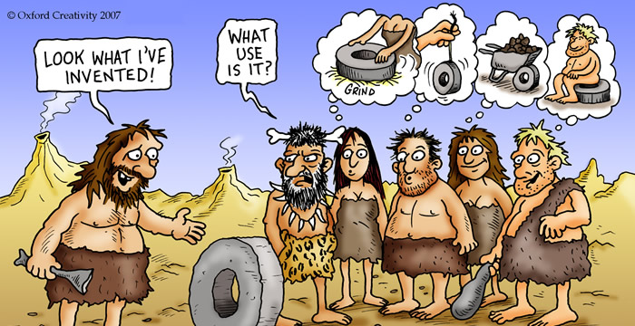
Image copyrighted by
Oxford Creativity 2007
Oxford TRIZ illustrated by Clive Goddard
https://www.toolshero.com/problem-solving/triz-method/
Notes:
Attribution

Slide 51

TRIZ espouses 5 basic principles for innovation initiatives. TRIZ uses 40 inventive principles to facilitate innovations.
01|
The ideal end result
It is important not to be complacent with some solution.
There is always a better solution.
Strive to find improvement and aim at an ideal solution.
However, we should remain mindful of the 80:20 rule

Slide 52
The 5 basic principles of TRIZ for innovation initiatives.
02|
Less is more
This is related to lean manufacturing ethos.
You must try to cut everything that can be eliminated without compromise on the fundamental functionalities.
Spend the least possible amount of money.
Chances are the objective can be realized with available materials and sometimes the solution is close at hand.

Slide 53
The 5 basic principles of TRIZ for innovation initiatives.
03|
Solutions already exist
Almost all problems can be solved using some existing principles.
One has to search within and outside the specific knowledge domains in search for solutions.
This can reduce time, money, and man-hours and accelerate the innovation process.

Slide 54


The 5 basic principles of TRIZ for innovation initiatives.
04|
Search for fundamental contradictions
Problems can be thought of as contradiction to solutions.
Most problem-solution has conflicting requirements.
If the contradictions can be accurately identified, solution will emerge. Don’t compromise.

Slide 55
The 5 basic principles of TRIZ for innovation initiatives.
05|
Lines of evolution
All systems are part of nature.
Nothing evolves in nature randomly that drastically disrupts nature.
Changes follow some patterns and by studying the patterns, it is possible to predict how technology has to evolve.

Slide 56
TRIZ IS
A way of accessing the collective creativity of humanity built over centuries
A set of systematic thinking tools to help you think systematically in innovation process
Invention
An attitude to problem solving that can accelerate the process of finding solution

Slide 57
Some wonderful reference material by Oxford Creativity
https://www.slideshare.net/assocpm/structured-innovation-for-pm-triz-problem-solving-method
https://www.toolshero.com/problem-solving/triz-method/

Slide 58
Book reference
Simplified TRIZ: New Problem Solving Applications for Technical and Business Professionals - by - Kalevi Rantanen, David W. Conley, Ellen R. Domb, Publisher: Productivity Press;Taylor & Francis, Year: 2018
Web resources:
http://www.triz40.com/

Slide 59
TRIZ
TRIZ is considered an Algorithm.
It is a step by step process and can be termed an empirical method.
It’s primary premise is that innovation can be taught.
Also that problems may be coded, classified and solved methodically.
Applying TRIZ helps to reduce the number of trials & make some kind of quick short-cut to solution.

Slide 60
40 Principles
Trends of Technical Evolution Effects Database
76 Inventive Standard
World’s Conceptual Problems
World’s Conceptual Solutions
39 Elements
Concept of Ideality
Triggers the required solution
Abstraction
Your Problem
Your Solution
Traditional Approach

Slide 61
TRIZ may reduce Product Development Time, Cost, and other Resources and Ensure Greater Success.
Manufacturing industry averages about one product success for every 3,000 ideas generated.
This proportion has remained virtually unchanged over the past many decades.
So companies waste approximately half of their development budgets on products that never reach the consumer or that fail after commercialization.
One problem is that new products lack design sensibilities.
The dilemma is that companies have to innovate to remain competitive.
TRIZ attempts to circumvent the many mediocre solutions and get directly to the best solution faster.

Slide 62
39 Parameters or contradictions and 40 Inventive Principles
Altshuller identified 39 contradictions or parameters and 40 inventive principles.
In TRIZ process, each innovative initiative can be related to one or more of these principles that would help a solution.
To arrive at the appropriate inventive principle, one has to be able to identify the right contradiction in a matrix.
Once the inventive principles are located, the problem solving process can begin.

Slide 63
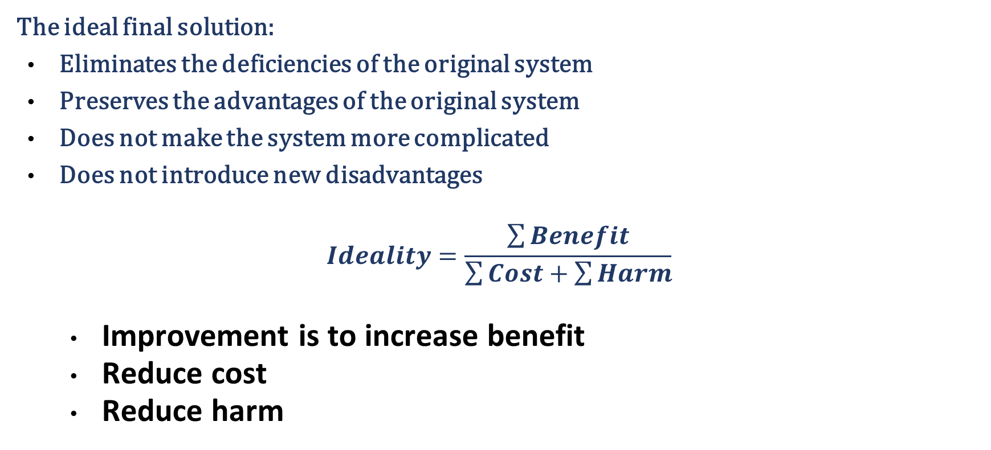
Ideality: A Metric to Measure Progress Towards the Ideal Final Result (IFR)
The ideal final solution:
Eliminates the deficiencies of the original system
Preserves the advantages of the original system
Does not make the system more complicated
Does not introduce new disadvantages
$$Ideality=\frac{\sum{Benefit}}{\sum{Cost}+\sum{Harm}}$$
Improvement is to increase benefit
Reduce cost
Reduce harm

Slide 64
The 39 TRIZ Features for technical contradictions or Technical parameters or Problem parameters
1: Weight of moving object | 14: Strength | 27: Reliability
2: Weight of stationary object | 15: Durability of moving object | 28: Measurement accuracy
3: Length of moving object | 16: Durability of non moving object | 29: Manufacturing precision
4: Length of stationary object | 17: Temperature | 30: Object-affected harmful
5: Area of moving object | 18: Illumination intensity | 31: Object-generated harmful
6: Area of stationary object | 19: Use of energy by moving object | 32: Ease of manufacture
7: Volume of moving object | 20: Use of energy by stationary object | 33: Ease of operation
8: Volume of stationary object | 21: Power | 34: Ease of repair
9: Speed of object | 22: Loss of Energy | 35: Adaptability or versatility
10: Force (Intensity) | 23: Loss of substance | 36: Device complexity
11: Stress or pressure | 24: Loss of Information | 37: Difficulty of detecting
12: Shape | 25: Loss of Time | 38: Extent of automation
13: Stability of the object | 26: Quantity of substance | 39: Productivity

Slide 65
Porous materials
Color changes
Homogeneity
Discarding and recovering
Parameter changes
Phase transitions
Thermal expansion
Strong oxidants
Inert atmosphere
Composite material films
Altshuller’s 40 Principles of invention of TRIZ
Skipping
“Blessing in disguise”
Feedback
‘Intermediary’
Self-service
Copying
Cheap short-living
Mechanics substitution
Pneumatics and hydraulics
Flexible shells and thin films
Segmentation
Taking out
Local Quality
Asymmetry
Merging
Universality
“Nested doll”
Anti-weight
Preliminary anti-action
Preliminary action
Beforehand cushioning
Equipotentiality
The other way around
Spheroidality
Dynamics
Partial or excessive actions
Another dimension
Mechanical vibration
Periodic action
Continuity of useful action

Slide 66
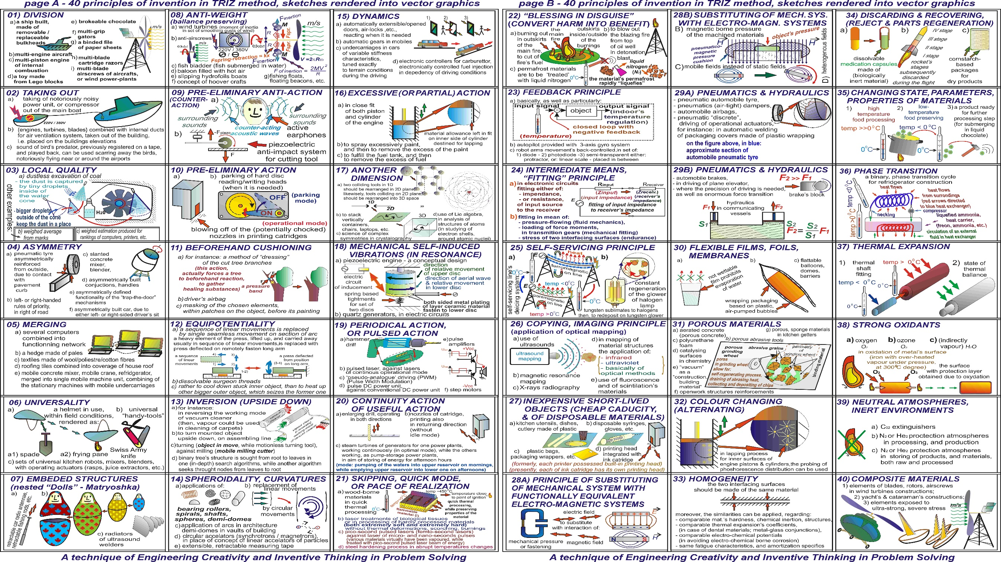
Source: wikipedia

Slide 67
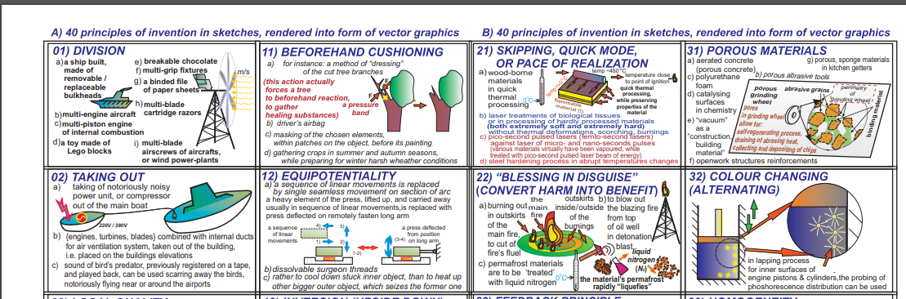
TRIZ – developed by Genrich Altshuller
Image from https://en.wikipedia.org/wiki/TRIZ
39 Parameters and 40 Inventive Principles

Slide 68
Steps
Identify contradictions of your problem solving context.
Locate one-set of the contradictions in the matrix leading to a particular cell in the matrix.
You find four (or less) numbers in the cell.
Find the invention principles corresponding to these numbers in the cell from the list of 40.
Interpret the possible and relevant inventive actions out of the many that the inventive principles may indicate.

Slide 69
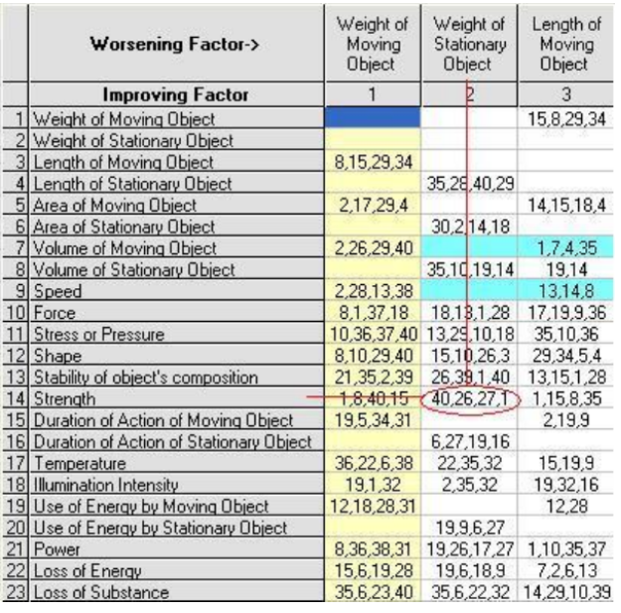
Making a table that is strong but lightweight
Contradiction matrix

Slide 70
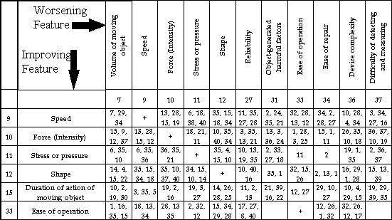
Contradiction Matrix of the Airbag problem Row 15 & Column 31

Slide 71
Principle 21. Skipping
A. Conduct a process , or certain stages (e.g. destructible, harmful or hazardous operations) at high speed.
Principle 39. Inert atmosphere
A. Replace a normal environment with an inert one.
B. Add neutral parts, or inert additives to an object.
Notes:
Use a high speed dentist’s drill to avoid heating tissue.
Cut plastic faster than heat can propagate in the material, to avoid deforming the shape.
Inflate the air bag faster than current practice, so that it is fully inflated when the small person impacts it.
Prevent degradation of a hot metal filament by using an argon atmosphere.

Slide 72
Principle 16. Partial or excessive actions
A. If 100 percent of an object is hard to achieve using a given solution method then, by using ‘slightly less’ or ‘slightly more’ of the same method, the problem may be considerably easier to solve.
Principle 22. “Blessing in disguise” or “Turn Lemons into Lemonade”
Use harmful factors (particularly, harmful effects of the environment or surroundings) to achieve a positive effect.
B. Eliminate the primary harmful action by adding it to another harmful action to resolve the problem.
C. Amplify a harmful factor to such a degree that it is no longer harmful.

Slide 73
TRIZ Is an Empirical Method
TRIZ reduces number of iterations [so 99% perspiration may be reduced].
There are several methods for increasing innovation.
Brainstorming
Synectics
Lateral Thinking
Neuro-linguistic Programming
Mind Mapping
TRIZ is designed to overcome Psychological Inertia, which is due to habits, education, paradigms, internal processes, past successes, past failures.
TRIZ directs the solution path using a problem-solution matrix.
Notes:
Vertical thinking is a type of approach to problems that usually involves one being selective, analytical, and sequential. It could be said that it is the opposite of lateral thinking. Unlike lateral thinking that involves using added intuition, risk taking, and imagination through unconscious and subconscious processes, vertical thinking consists of using more of a conscious approach via rational assessment in order to take in information or make decisions. This type of thinking encourages individuals to employ a sequential approach to solving problem where a creative and multidirectional response are seen as imprudent. Vertical thinkers prefer to rely on external data and facts in order avoid failure or counterfactual thinking.
Increase the volume of powdered detergent by adding inert ingredients. This makes it easier to measure with conventional tools.

Slide 74
The graphical presenetation has been prepared based on the presentation by NASA at https://www.slideshare.net/PersianGuru/triz2-12304568450882912
An exhaustive set of possible solution concepts
Number of solutions for reliable choice
Confident decision point
TRIZ Method
Conventional Method
Deadline: Forced decision point

Slide 75
Six Concepts
The problem-solving model uses six concepts:
Contradiction
Resources
The ideal final result
Functional analysis
The patterns of evolution (called “the increase of interactions.”) and
Innovative principles.

Slide 76
Six Concepts
Contradiction: Solving a problem means removing a contradiction.
Resources: Resources are available, but idle and often invisible substances, energy, properties, and other things in or near the system can be used to resolve the contradiction.
Ideal Final Result: The Ideal Final Result is achieved when the contradiction is resolved. The desired features should be obtained without compromise.

Slide 77
Six Concepts
Functional analysis: Systems exist to create a functional output. Understanding systems functionally provides great insight into how the output is achieved and uncovers problems (contradictions), potential resources and, therefore, opportunities.
Patterns of evolution: Systems evolve according to certain patterns, not accidentally. The patterns can be used many ways to get new ideas and predict the evolution of the system.
Innovative principles: These principles give concrete cues for solutions and illustrate what the patterns can mean.

Slide 78
Design Form, function and experience It is a rejection of the practice of viewing a product as a bunch of features stacked together.

Slide 79
Design Process
Step 1
Define
The problem
Step 2
Collect
information
Step 3
Brainstorm
& analyse
ideas
Step 4
Develop
Solution/build a model
Step 5
Present your ideas to others for feedback
Step 6 Improve
your design
The Design Process is a systematic approach to break down the phases of developing solutions to variety of problems.
THE DESIGN PROCESS
Source: https://www.discoverdesign.org/handbook

Slide 80
Design Thinking for developing products, processes, services

Slide 81
Design Thinking
Design thinking is “a discipline that uses the designer’s sensibility and methods to match people’s needs with what is technologically feasible and what a viable business strategy can convert into customer value and market opportunity.” - Tim Brown of IDEO
Thinking like a designer can transform the way you develop products, services, processes—and even strategy.

Slide 82
“To harvest the power of design thinking, individuals, teams, and organizations have to cultivate optimism. People have to believe that it is within their power to create new ideas that will serve unmet needs and that will have a positive impact.” - Tim Brown
Whether you believe it or not, you are a designer. You have the ability to make observations about your surroundings, create simple prototypes, and experiment with new solutions.

Slide 83
Continued
In the process you can be more creative.
Your designs will increasingly match the needs of the target group.

Slide 84
Design Thinking
Encourages people to explore alternatives
Creating options that did not exist before
Focuses on the needs of the users.
It is not just about the functionality
It is about sensibilities. , it is about the context, the culture of the stakeholders.
Direct observation and qualitative data whcih creates stories that people can empathise with. once the problem is understood the problem solver is more apt to define what the real problem.
after diagnosing the true problem its time to ideate or brainstorm new ideas without the constraints of existing solutions because Design thinkers learn by doing these radical ideas are then made into simple prototypes that test possible outcomes rapid prototyping speed up the innovation process.
The process of ideating, prototyping and testing is repeated early on so that mistakes are quick cheap and ultimately lead to success. So, why design thinking?
Stanford - David Kelley & Tim Brown

Slide 85
Design Thinking: More Explanation
Design Thinking is a methodology that imbues the full spectrum of innovation activities with a human-centered design ethos.
Need to designing products or services through direct observation, of what people want and need in their lives and what they like or dislike about the way particular products are made, packaged, marketed, sold, and supported.

Slide 86
Design Thinking: Design Mindset
A design mindset is not problem-focused, it's solution focused and action oriented towards creating a preferred future.

Slide 87
Effective design thinking entails more than applying design methods. To produce the best outcomes, organizations need to develop — and trust — peoples’ design sensibilities.
Design thinking is receiving a great deal of attention as increasing numbers of innovative organizations succeed in solving complex problems by creative means. In doing so, many of these firms implement specific "design methods" such as observational research, iterative prototyping and storytelling alongside more mainstream approaches. But as any professional designer will attest, design thinking entails much more than applying methods: to create value, methods must be applied together with design sensibilities.
You have to be able view the world in someone else’s perspective. Can you appreciate the architectural beauty of a city as an architect would do?

Slide 88
Design Thinking Steps to Innovation
EMPATHIZE
IDEATE
DEFINE
PROTOTYPE
TEST

Slide 89
Design Thinking
EMPATHY
Observe and interview users in their natural environment, know their pain by suffering it
Generate insights and define the problem(s) to be solved
IDEATE
Brainstorm a diverse array of possible solutions
Garner positive and negative feedback from users
PROTOTYPE
Create a visual representation of several promising concepts
TEST
DEFINE

Slide 90
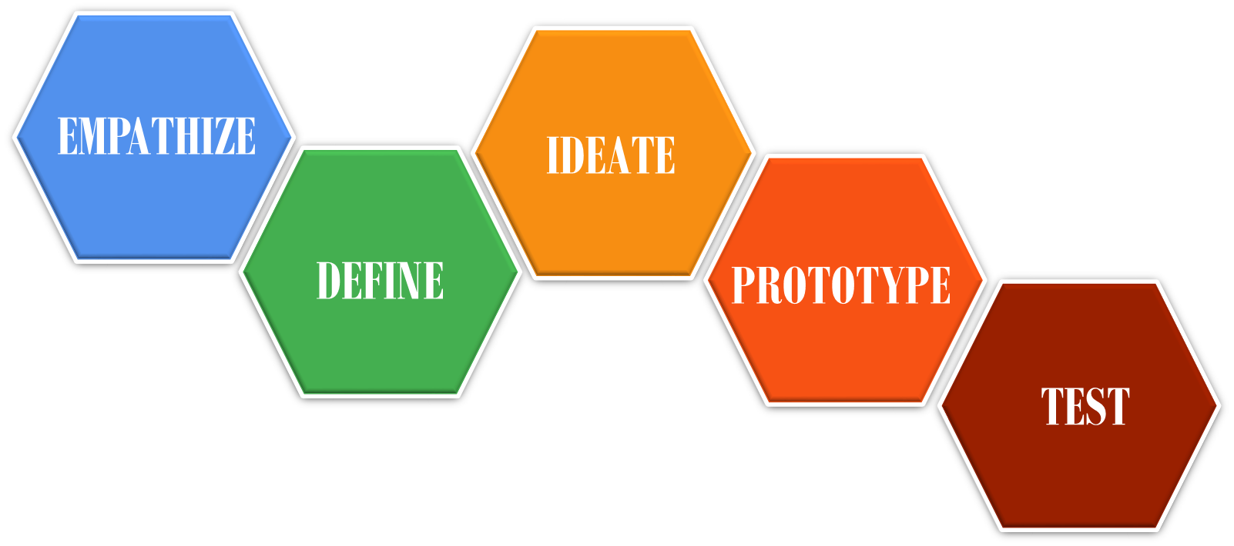
Empathize
The best solutions come out of the best insights into human behavior.
Design Thinking is about getting outside your own perspective and getting informed and inspired by the people you’re creating for.
Why?
Because our minds automatically filter out a lot of information without us even realizing. We need to see things “with a fresh set of eyes,” and empathizing gives us those new eyes.

Slide 91
Empathize
Observe – understand the challenges
Listen – new ideas should be inspired by the description of the problem by the users. Sometimes users come up with great new ideas.
Watch and engage – It is the combination of the above two.
Understand the perspectives of users you are designing for is the foundation of human-centered innovation.
Empathizing enables to discover the emotions that guide peoples’ behavior and helps to capture physical manifestations of experiences.
Your understanding defines the design space to a large measure.

Slide 92
Define and Redefine (the problem)
Empathizing gives the sense of the issue and define the problem.
The goal is to craft an actionable problem statement.
Synthesize the information, discover the connections and patterns.
Comprehensiveness of the solution depends on how comprehensively you define the problem an aspiration of the customers.
Continue to define and redefine the problem statement from the user perspective in order to generate more profound ideas for the purpose of developing thorough human-centered prototypes.

Slide 93
Ideate
There are always many possible solutions. Try stepping beyond obvious solutions and increase the innovation potential of your solution set.
Avoid following the bitten track or preconceived path. Uncover unexpected areas. Don’t throw away any idea as being crazy.
Brainstorm to harness the collective perspectives and strengths of your teams. Listen to all and curate discrete ideas into optimum solution.
During the process, you are expected to generate lots of ideas till you find the unique solutions.

Slide 94
Divergence and convergence

Slide 95
Idea Generation
Design thinking advocates generation of large number of ideas without much attention to tenability, practicality, or realism.
Let there be divergence of ideas at the beginning.
Analyze all ideas without bias and gradually converge to a limited number, may be one or two for further brainstorming and prototyping.
Keep a sharp eye on users’ perspective from all possible angles such as economy, culture, unique environment of working, available infrastructure & utilities (road, power, fuel, water), maintainability, serviceability, preservability, etc.
Converge to the best possible framework of the design under given circumstances.

Slide 96
Prototype
Prototyping is revealing. Challenges remain hidden at the idea stage. Ideas are intangible. Prototype provides realistic view and you get to know the limitations of the idea.
Prototype provides opportunity for fast failing and you can pivot with refined ideas limiting the time and resources spent on an untenable idea.
Prototype enables a practical engagement with the users and you get deeper empathy.
Build rough prototypes to learn how to make ideas better.

Slide 97
Test
Put the prototype to perform in the actual context, invite the users, check the efficacy, get feedback.
Be mindful that users are not always complete in describing their problem and scope of possible solution. They will reveal further once the prototype is before them. In the process, you get deeper understanding of hidden user needs.
Expect negative surprises that will help redesign or ideate afresh.

Slide 98
Redefine if necessary
Continuously obtain customers’ feedback and solve residual issues, meet their incremental expectations and aspiration.
With all the hard work, a product launched successfully may not be able to receive growing customers’ acceptances. Further refinements (at times complete redesigning) is almost always necessary.

Slide 99
Profile of a Design Thinker - 1
Empathy.
They can imagine the world from multiple perspectives—those of colleagues, clients, end users, and customers (current and prospective). By taking a “people first” approach, design thinkers can imagine solutions that are inherently desirable and meet explicit or latent needs.

Slide 100
Profile of a Design Thinker - 2
Integrative thinking.
They not only rely on analytical processes (those that produce either or choices) but also exhibit the ability to see all of the salient—and sometimes contradictory—aspects of a confounding problem and create novel solutions that go beyond and dramatically improve on existing alternatives.

Slide 101
Profile of a Design Thinker -3
Optimism.
They assume that no matter how challenging the constraints of a given problem, at least one potential solution is better than the existing alternatives.

Slide 102
Profile of a Design Thinker -4
Experimentalism.
Significant innovations don’t come from incremental tweaks. Design thinkers pose questions and explore constraints in creative ways that proceed in entirely new directions.

Slide 103
Profile of a Design Thinker -5
Collaboration.
The increasing complexity of products, services, and experiences has replaced the myth of the lone creative genius with the reality of the enthusiastic interdisciplinary collaborator.
The best design thinkers have significant experience in more than one domains.
IDEO is known to employ people who are engineers and marketers, anthropologists and industrial designers, architects and psychologists.

Slide 104
Design and Simplicity
“That’s been one of my mantras — focus and simplicity. Simple can be harder than complex. You have to work hard to get your thinking clean to make it simple. But it’s worth it in the end because once you get there, you can move mountains.” - Steve Jobs
Simplicity - It is a design philosophy that is championed by many successful companies and fans of the products made by those companies alike.

Slide 105
Four Ways to Make the Design Simple
Maintain Clarity: Understand and Design for your Users’ Main Goals
Make Use of Automation: Design for a Minimum Amount of Conscious and Cognitive Effort
Limit Options: Design for a Strong “Information Scent”
Reduce the Gulf of Execution: Make your Users see how your Product can Help them Achieve their Goals
Notes:
Information scent refers to the extent to which users can predict what they will find if they pursue a certain path through a website. The term is part of information foraging theory, which explains how users interact with systems using the analogy of animals hunting for food.
The gulf of execution is the gap between a user's goal for action and the means to execute that goal.

Slide 106

A cluttered complex design of a landing page

Slide 107

Simplified with transformative change in customer acquisition

Slide 108
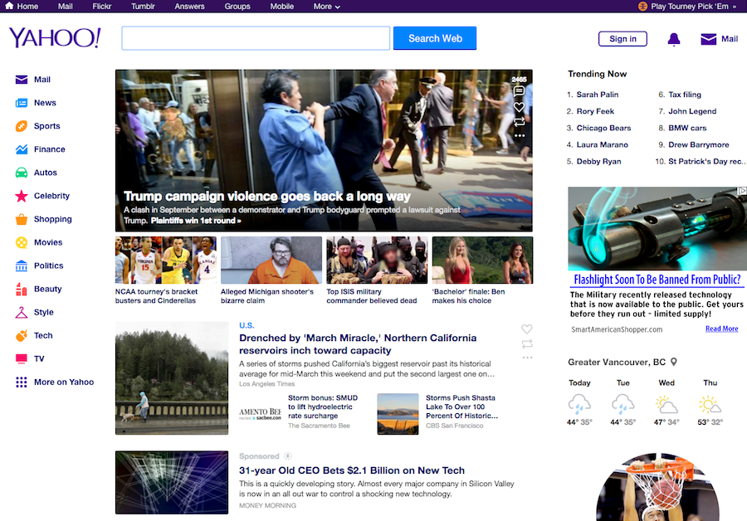
Compare this with Google

Slide 109
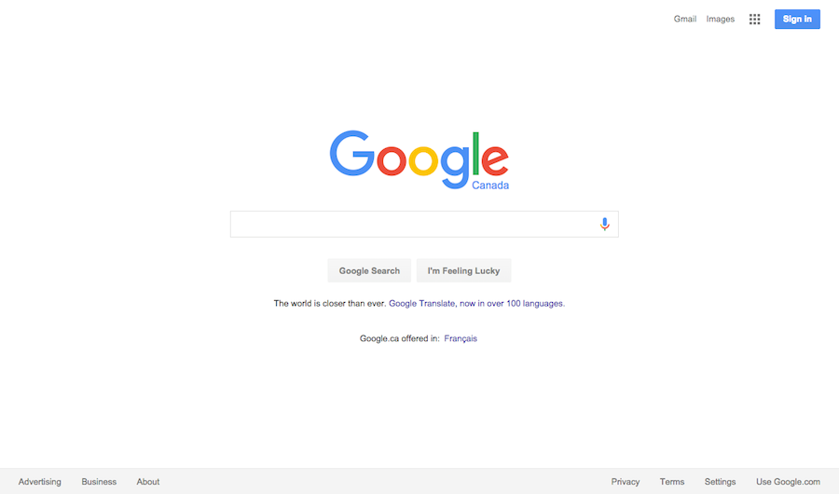
Simple design

Slide 110
Open Innovation

Slide 111
Definition
Open innovation is the “use of purposive inflows and outflows of knowledge to accelerate internal innovation, and expand the markets for external use of innovation , respectively (Henry Chesbrough, 2003).
The boundaries of companies adopting open innovation are permeable allowing sharing of resources with the external entities.

Slide 112
Definition
“Open Innovation is a paradigm that assumes that firms can and should use external ideas as well as internal ideas, and internal and external paths to market, as the firms look to advance their technology.” - Henry Chesbrough

Slide 113
Developing Technology in Isolation Is not Easy
Any product or process has several constructs.
Developing every construct requires new ideas.
The process of generating new ideas, refining and testing them requires time, resources, and intellectual capital.
It may be difficult for any single company to master all of them and develop a complete product or process very economically.
It is rather easier to add incremental value and add new designs to existing product.

Slide 114
Open Innovation and the Contrary
Open innovation (OI) embraces external ideas and knowledge in conjunction with internal R&D.
Firms that can harness outside ideas to advance their own businesses, while leveraging their internal ideas outside their current operations, will likely thrive in this new era of open innovation.
Others (not adopting OI), who are internally oriented, have centralized approach to R&D.

Slide 115
External Use of Innovation
Xerox discarded many of their innovations terming them as commercially irrelevant.
Many startups took those technologies, refined them to suit customer requirements and have become successful entrepreneurs.
The combined market value of those spinoffs entities more than exceeded Xerox’s own market value.
It may be viewed as open innovation from the perspective of those spinoffs.

Slide 116
Open Innovation
•
•
•
•
•
•
•
Science &
technology
base
•
•
•
•
•
•
The market
New products/
services
Research
investigations
•Development
Licensing
Technology spinoffs
•
•
•
Other firm's market
•
•
•
Internal
technology
base
•
New market
•
•
•
•
•
•
•
•
•
•
•
•
•
Current market
•
•
•
External
technology
base
Technology insourcing

Slide 117
Innovations at Xerox that helped several successful companies
Graphical interface
Bitmap screen
Ethernet networking protocols
Font rendering program, PostScript
Web searching
Indexing technologies
Online conferencing technologies

Slide 118
Apple
Adobe
Microsoft
Total about 30 companies that took birth based on technologies that Xerox invented but failed to commercially exploit.

Slide 119
Open Innovation: Advantages
Accelerate development process
Reduces cost of product development
Reduces resources requirement
Reduces skill gaps
Help to beat competition
It reduces risk

Slide 120
A current example of open innovation involving an Indian laboratory and an American company
Aug 16, 2017: A new research program aims to capitalize on CSIR-IMTECH's world-class expertise in microbial technology and the proven R&D capabilities of Johnson & Johnson's pharma company Janssen to strengthen the collective potential of both entities.
Initiated co-development of new drugs for treatment of tuberculosis.
http://timesofindia.indiatimes.com/business/india-business/india-may-become-the-first-country-to-roll-out-tb-treatment/articleshow/60084271.cms

Slide 121
Ongoing Open Innovation: Examples
Eli Lilly pioneered the modern idea of crowdsourcing in 2001 when they began to post research questions openly (online) to scientists and outsiders to augment their own R&D efforts. From this effort, they developed and spun off a new company—InnoCentive—to offer crowdsourcing to other companies.
X-Prize: the X-PRIZE Foundation sponsors many competition and offer millions of dollars of prize money for solving critical problems.
HeroX, a subsidiary of X-Prize, invites ideas for solving corporate and government problems against payment.

Slide 122
Open Innovation in Gaming
The use of “beta invitations” has been practiced for decades in the video game industry. In this model, which could be considered a form of OI crowdsourcing, a software developer releases a “beta” (or early, likely flawed) version to users for testing and commentary.
This results in many expert hours of development being applied in a short time, thereby improving the product quickly and cost‐effectively.

Slide 123
Problems with open innovation
Trust is difficult to build. Your valuable idea may be shared with your competitors.
It is difficult to pin down the exact ownership of part ideas.
There is also a chance that some teams, if not all, may have inflated impression about the worth of their ideas which may lead to disappointments.
More daunting worry is that the adage that “great” ideas can’t come from a crowd, which inherently produce compromise and mediocrity.

Slide 124
Open innovation: the case of Procter & Gamble
Procter & Gamble’s radical strategy of adopting open innovation for technology/product development now helping them in producing more than 35% of their innovations and billions of dollars in revenue.

Slide 125
P&G
CEO A.G. Lafley decided that up to 50% of innovation must come in from the outside.
Pringles potato chips: they discovered a bakery in Bologna, Italy run by a university professor who had already come up with a way of printing edible images on cakes and cookies and it only needed a few tweaks to be adapted to solve P&G’s problems.
Through a licensing partnership with OraLabs, Procter & Gamble market a number of different products, including Breath Mist, a fresh breath vaporizer and Scope Minibrush, an on-the-go toothbrush that doesn't require water.
P&G continues its efforts of open innovation with more than 2,000 partners all over the world. This is a key plank of its strategy to deliver year-on year growth.

Slide 126
Syllabus up to here.

Slide 127
Intellectual Property Rights (IPR)
Patent
Design
Trademark
Copyright
Geographical indications
Plant variety protection
Semiconductor integrated circuit layout design

Slide 128
Patent
The right to an invention can be protected through patent.
Must meet three criteria:
Novelty – uniqueness
Non-obviousness – inventive steps through which the knowledge has been created. Should not be obvious to a person skilled in the art.
Industrial use – commercial relevance
Patent is protected for a maximum period of 20 years from the date of filing and within the territory where the patent application is valid.

Slide 129
Design
Unique features such as shape, pattern, composition, configuration, color combination, etc. making an object uniquely differentiated from the look of it.
Valid initially for 10 years and can be extended for 5 more years.

Slide 130
Trademark
A unique text, symbol, device, logo, label, name, sign, number, shape, drawing, picture, emblem, and unique combination of any two or more of the above fall under trademark.
Trademark is meant to be an identifier of a product or service around which a company creates value and customers build their perception on the quality, reliability, and efficacy of the product or services represented by the trademark.
Valid initially for ten years and renewable indefinitely.
Registering of trademark is not compulsory.

Slide 131
Copyright
Protects the right of creator on literary work, art, music, dramatic, cinematographic, sound recording, software code, and other mental unique creation of commercial value.
Valid for 60 years after the death of the creator.

Slide 132
World Intellectual Property Organization (WIPO)
PCT or patent cooperation treaty – provides protection on your invention for 30 months from the priority date (first filing date).
Without PCT, your invention will be protected only in those countries where you file patent application for protection and maintain.

Slide 133
On a different note: Four Steps to Epiphany
Most startups lack a process for discovering their markets, locating their first customers, validating their assumptions, and growing their business.
All successful companies invent a customer development model.
The model in simple form
Customer discovery
Customer validation
Customer creation
Company building

Slide 134
You should under-promise and over-deliver

Slide 135
References:
Design-driven Innovation: Changing the Rules of Competition by Radically Innovating what Things Mean – by Roberto Verganti , Harvard Business Press (2009)
Entrepreneurship: New Venture Creation by David H. Holt, Pearson (2016)
Open Services Innovation: Rethinking Your Business to Grow and Compete in a New Era by Henry Chesbrough, Wiley (2010)
https://en.wikipedia.org/wiki/TRIZ
Images from pixabay.com, pexels.com, freeimages.com, stickpng.com

Slide 136
Conclusion:
Continuous innovation is indispensable for sustaining successful business ventures.
The ability to innovate is, thus, a vital and essential component of entrepreneurship itself.
Innovation may be difficult but it is possible.

Slide 137

https://unsplash.com/s/photos/background for images
Ries, E. (2011). The lean startup: How today's entrepreneurs use continuous innovation to create radically successful businesses. Crown Books.
Book Summary: The Lean Startup By Eric Ries
Kander, Diana. All in Startup: Launching a New Idea when Everything is on the Line. John Wiley & Sons, 2014.
Kim, D., & Boradkar, P. (2003). Sensibility Design. In International Design Education Conference, IDSA (pp. 155-163).
Michael A. Roberto. Igniting Creativity - Dismantling Barriers to New Ideas (2019, Wiley)
http://info.boardofinnovation.com/hubfs/Validation%20Guide%20compressed.pdf
Various Wikipedia pages
Moore, G. A., & McKenna, R. (1999). Crossing the chasm.
Mulder, P. (2016). TRIZ Method. Retrieved [insert date] from ToolsHero: https://www.toolshero.com/problem-solving/triz-method/

Slide 138


Slide 139
Design-driven Innovation: Changing the Rules of Competition by Radically Innovating what Things Mean – by Roberto Verganti , Harvard Business Press (2009)
Open Services Innovation: Rethinking Your Business to Grow and Compete in a New Era by Henry Chesbrough, Wiley (2010)
https://en.wikipedia.org/wiki/TRIZ
https://unsplash.com/s/photos/background for images
Books.
Book Summary: The Lean Startup By Eric Ries
Kander, Diana. All in Startup: Launching a New Idea when Everything is on the Line. John Wiley & Sons, 2014.
Kim, D., & Boradkar, P. (2003). Sensibility Design. In International Design Education Conference, IDSA (pp. 155-163).
Michael A. Roberto. Igniting Creativity - Dismantling Barriers to New Ideas (2019, Wiley)
Various Wikipedia pages
Ries, E. (2011). The lean startup: How today's entrepreneurs use continuous innovation to create radically successful businesses. Crown
Images from pixabay.com, pexels.com, freeimages.com, stickpng.com
Entrepreneurship: New Venture Creation by David H. Holt, Pearson (2016)

